Slide 1
All About Auto
Don’t panic!
https://github.com/JimWright4089/FIRSTWorkshops/FTC/2020

Slide 2
Intro
Things covered in this class:
State Machines
Encoder Test
Gyro
Your first Auto
Your second Auto

Slide 3
Intro
Note: in this talk the screens may not match yours. So adjust when you need to.

Slide 4
Intro
When you start writing a new robot program, start from another program.
Never start from a blank file.
Almost all the code in this class is on my Github page at: https://github.com/JimWright4089/FIRSTWorkshops/tree/master/FTC/2020/Source

Slide 5
Intro
Programs we will work with:
StateMachine01.java
StateMachine02.java
StopWatch.java
EncoderTest01.java
EncoderTest02.java
GyroTest01.java
GyroTest02.java
MyFirstAuto.java

Slide 6
Intro
Two ways of getting source on your phone.
Download and import (let’s not do this but talk about it)
Start a program and cut and paste

Slide 7
Download and import
You will need to download all of the files under FIRSTWorkshops.
Start at https://github.com/JimWright4089/FIRSTWorkshops
And click download from the Code button

Slide 8
Cut and paste
Start at your OnBotJava Screen.

Slide 9
Cut and paste
Enter the name of the program, and select Not an Opmode

Slide 10
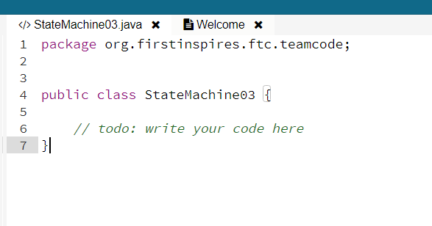
Cut and paste
When you select the new program, you get a short piece of code.

Slide 11
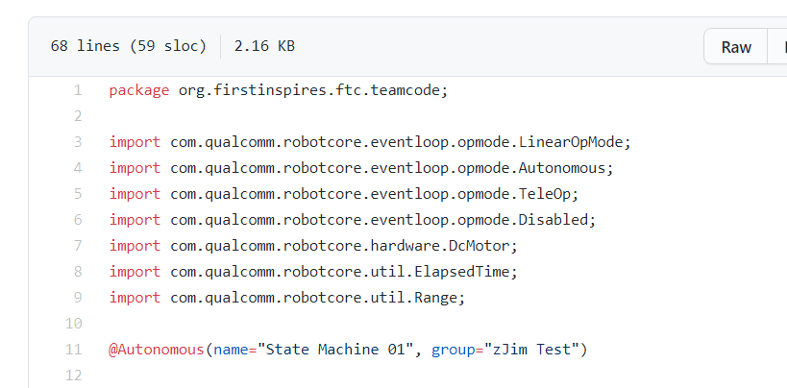
Cut and paste
Go to the github source, and hit the Raw button

Slide 12
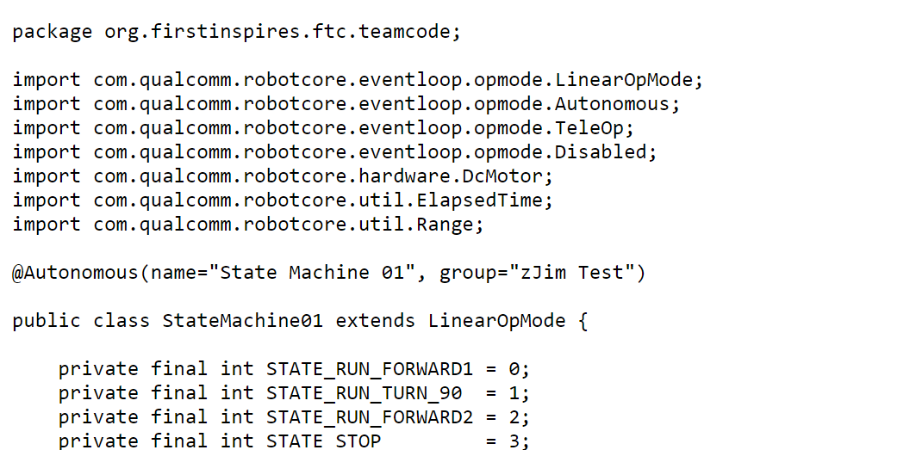
Cut and paste
Now you can CTRL-A,
CTRL-C to get the code.
Then CTRL-V into the onblock source file.

Slide 13
State Machine 01
See source and talk about

Slide 14
State Machine 02
See source and talk about source and StopWatch

Slide 15
Encoder Test 01
See source and talk about source

Slide 16
Encoder Test 02
See source and talk about source to clear encoder

Slide 17
Gryo Test 01
See source and talk about Gyro, then source

Slide 18
Gryo Test 02
See source and talk about simpler use of the gyro

Slide 19
MyFirstAuto.java
Build your first Auto program.
Then build a second one with using the Gyro.

